Slide 1
DEPARTMENT OF ELECTRONICS AND COMMUNICATION ENGINEERING Academic Year 2024-2025 (EVEN SEM)
ECB1223 – MICROCONTROLLER AND INTERFACING

Slide 2
GPS VEHICLE ACCIDENT ALERT SYSTEM
BY :
ARUN K - 927623BEC011
BALAJI C - 927623BEC015
BHARANIDHARAN S - 927623BEC016
BHARANITHARAN S - 927623BEC017

Slide 3
ABSTRACT
Road accidents are a major cause of accident in worldwide, and immediate medical assistance can significantly reduce the injuries. This project presents an Accident Alert and Location Tracking System that utilizes GPS (Global Positioning System) and GSM (Global System for Mobile Communications) to detect accidents and automatically notify emergency responders, nearby hospitals, and family members.
Key Features:
Automatic Accident Detection – The system uses impact sensors to detect an accident.
Real-Time Location Tracking – GPS provides precise location data of the accident spot.
Instant Notifications – GSM sends messages and calls to emergency contacts and hospitals.
Customizable Contact List – Family members' contacts can be updated as needed.
Prioritized Alerts – Messages are first sent to emergency services, followed by family members for quick response.

Slide 4
OBJECTIVE
To develop an Accident Alert and Location Tracking System using GPS and GSM that can detect accidents and automatically notify emergency services (ambulance, nearby hospitals) and family members through SMS and phone calls. The system will provide the precise location of the accident, ensuring quick response and medical assistance.
Additionally, the system will allow easy customization of family notifications so that only designated family members receive alerts. The system will focus on detecting accidents in nearby locations and ensuring timely intimation for effective emergency response.

Slide 5
PROBLEM STATEMENT
In many cases of road accidents, delay in emergency response leads to severe injuries and loss of life. The primary causes of these delays include:
Lack of immediate accident detection
Absence of real-time location tracking
No automated alert system for emergency contacts and hospitals
To address these issues, an Accident Alert and Location Tracking System using GPS and GSM can be implemented. This system will detect accidents using sensors, retrieve the accident location via GPS, and send instant alerts through SMS and phone calls to family members, nearby hospitals, and ambulance services. Additionally, it will provide an option to update emergency contact numbers easily for improved flexibility.
This system will ensure quick response times, potentially saving lives by reducing delays in medical assistance.

Slide 6
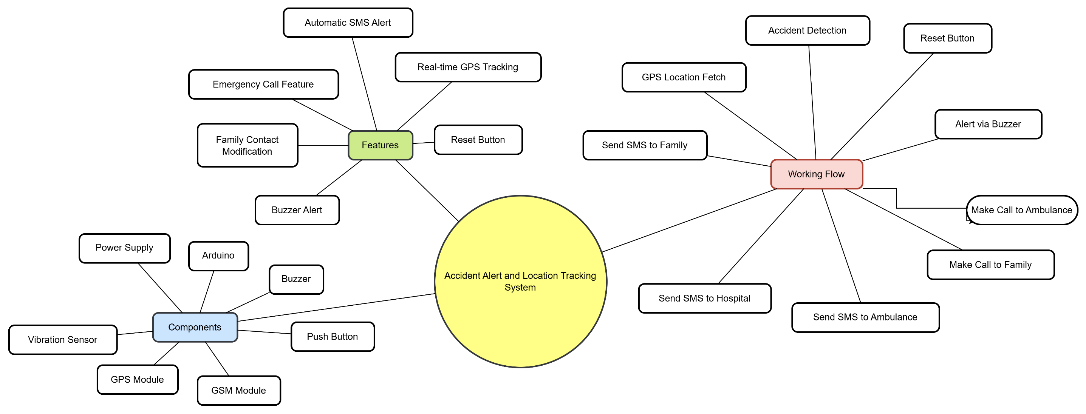
MIND MAP

Slide 7
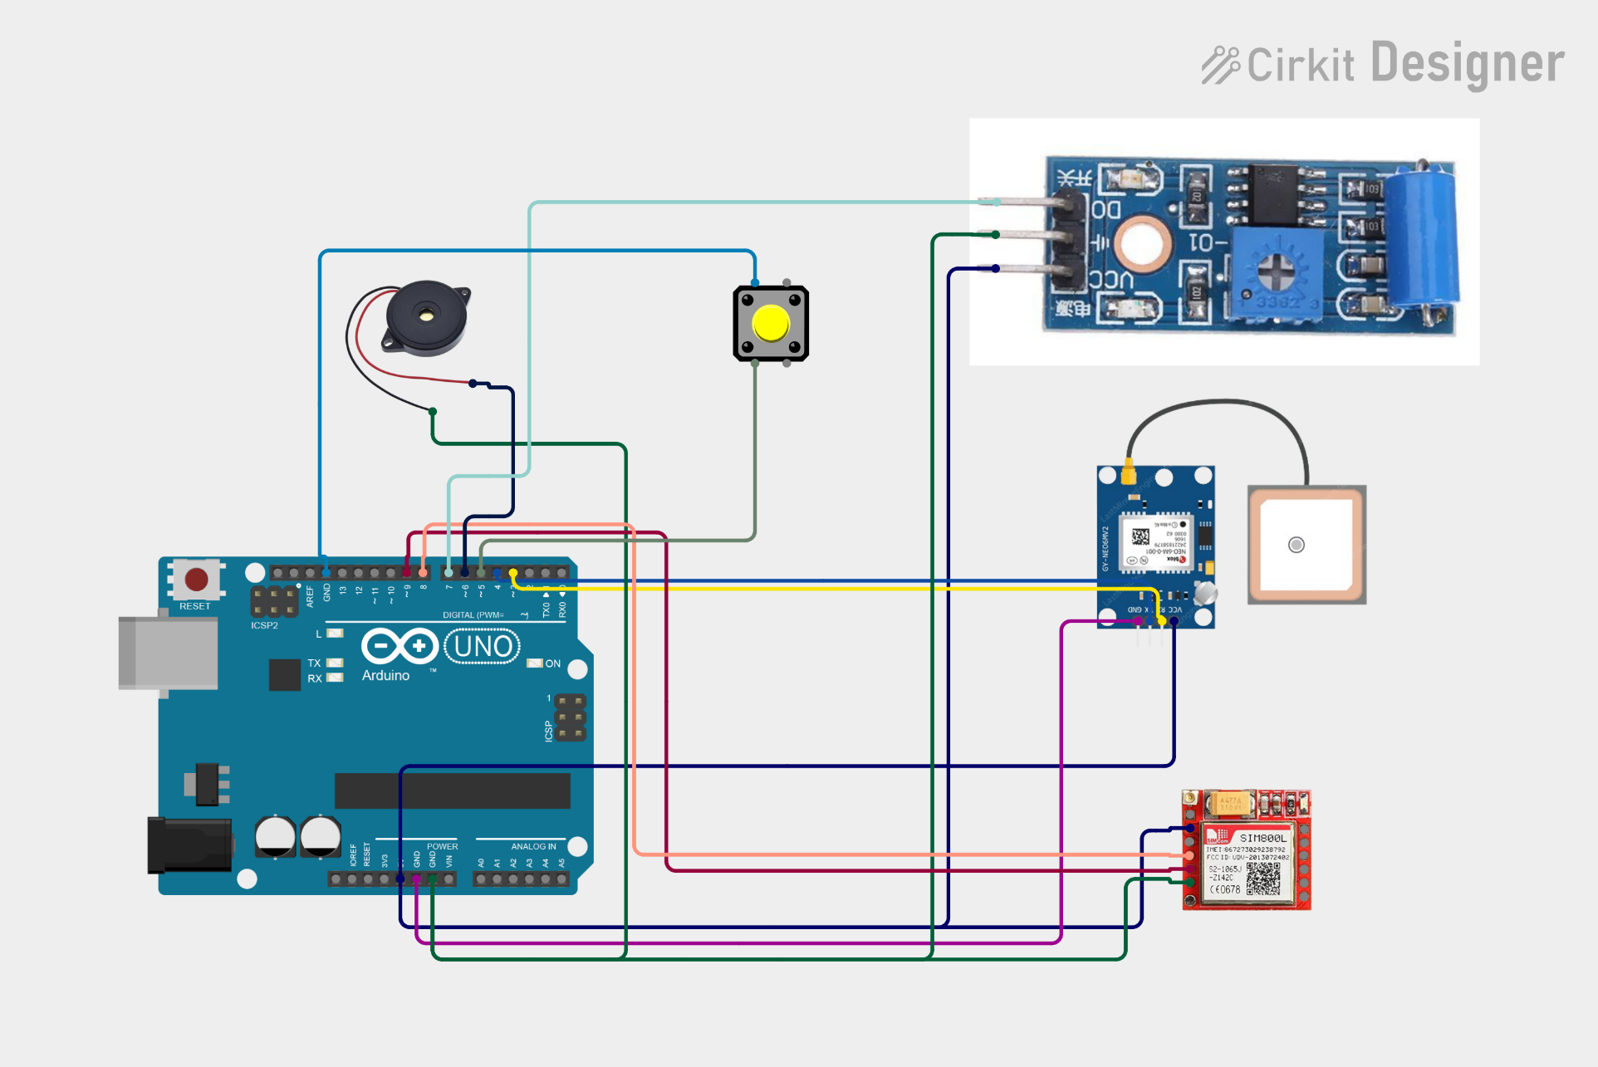
CIRCUIT DIAGRAM

Slide 8
COMPONENTS REQUIRED
Arduino Uno/Nano
GPS Module (Neo-6M)
GSM Module (SIM800L)
Vibration Sensor (SW-420) (for accident detection)
Buzzer (for alert sound)
Push Button (to reset system if false alert is triggered)
Power Supply (Battery/Adapter 9V-12V)

Slide 9
EXISTING SYSTEM
Existing accident alert and location tracking systems use vibration sensors, accelerometers, and GPS-GSM modules to detect crashes and send alerts via SMS or calls to emergency contacts. Some integrate Google Maps API for real-time tracking, while advanced versions use IoT for cloud-based monitoring. However, they have limitations like fixed emergency contacts, frequent false alarms, and lack of automated hospital selection. Enhancements such as dynamic contact selection, machine learning-based detection, voice-based severity assessment, and automated ambulance dispatch can improve efficiency and reliability.

Slide 10
FEATURES & ENHANCEMENTS:
✅ Real-time GPS Tracking
✅ Automatic SMS Alert with Location
✅ Emergency Call Feature
✅ Family Contact Easily Changeable
✅ Buzzer Alert for Awareness
✅ Reset Button to Avoid False Alarms

Slide 11
References
"Accident Detection and Alert System Using GPS and GSM" International Journal of Creative Research Thoughts (IJCRT), 2022. This paper discusses an automatic alert system for vehicle accidents that sends messages to registered mobile numbers using wireless communication techniques.
https://youtu.be/WNezQ0maD9I?si=IbAerBdy4qV7r_Uu
https://ajast.net/data/uploads/72031.pdf

